Slide 1
EXPERIMENTS
We only do an experiment to prove a hypothesis.
It ALWAYS has the same sections:
AIM: This is a short statement telling what you are AIMING to PROVE.
METHOD: This simply tells you (in a numbered step-by-step) what you need to DO. (A diagram can help clarify what your words have described.)
RESULT: Describes only what HAPPENED.
CONCLUSION: Briefly tells what you PROVED.

Slide 2
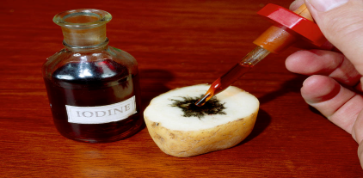
WHY DO WE DO THE STARCH TEST?
Experiment 1 shows how you test the leaf for the presence of starch. (The Starch Test.)
Experiments 2, 3, and 4 all finish with this Starch Test.
If there is starch in the leaf, this means that this leaf was photosynthesising, and storing some food.
The Leaf’s Procedure explains this:
1. It makes glucose (food).
2. It converts some glucose into starch, and stores it in the leaf (in case it needs any extra energy).
3. It sends the food made after this to the rest of the plant.
So: If you do the Starch Test and there is no starch in the leaf, then it was not photosynthesising, and therefore had to use its stored reserves.

Slide 3
QUESTIONS Page 35
Question 5
To see if Oxygen is released in PhotoSynthesis. [2]
1 to 2 bubbles per minute (at distance of 180 cm) [1]
140 cm [1]
Hold a glowing match in the gas. If it bursts into flames, this gas is Oxygen. [4]
CO2 concentration. Temperature. [2]
The further away the light, the fewer bubbles. The closer the light, the more bubbles. No increase when closer than 120 cm – plant is already working at maximum capacity. [4]
How quickly Oxygen is released = how quickly photosynthesis is happening. [2]

Slide 4
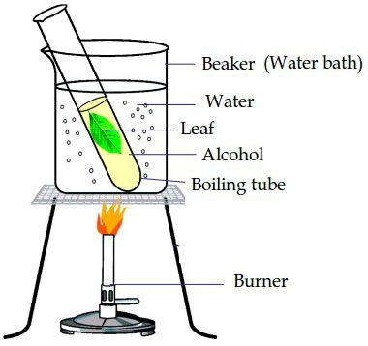
Question 6
To let it photosynthesise, make food, store starch. [2]
Stop all its functions. Soften its tissue. [2]
Goes from green to colourless [1]
Takes the chlorophyll out of the leaf. [2]
5. Do not heat it on a flame – easily flammable. [2]
6. Palisade MesoPhyll. Spongy MesoPhyll. Stomatal (Guard) cells. [3]
7. Black [1]
8. Starch is present in the leaf. [2]

Slide 5
Question 7
Let it use up all its food reserves so there is no starch in the leaf. [2]
Put it in a dark cupboard for 48 hours. [2]
Areas exposed to light were positive for starch – those in the dark could not make food to produce starch. [4]
SunLight is essential for the process of PhotoSynthesis. [2]
To remove all the starch so you can see where subsequent photosynthesis takes place. [2]
It was not properly de-starched – there was still starch stored across the whole leaf. [2]

Slide 6
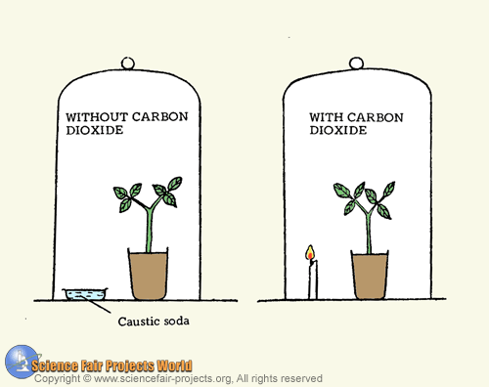
Question 8
Because its green areas have chlorophyll and its white areas do not. [2]
Green areas tested positive for starch. Clear areas tested negative. [2]
Experiment: Green. Control: Clear. [2]
ChloroPhyll is essential for PhotoSynthesis. [2]
Question 9
To see if CO2 is needed for PhotoSynthesis. [2]
Soda lime. Caustic soda. [2]
To seal it and control the amount of CO2 in it. [2]
To allow PhotoSynthesis to occur. [2]
Yellow [1]
Black [1]
CO2 is needed in PhotoSynthesis. [1]

Slide 7
Question 10
To show effects of different light intensities on rate of PhotoSynthesis in different concentrations of CO2. [2]
2. [1] for each of: Heading (X & Y). X=Light Intensity. Y=Rate of PhotoSynthesis. Regular spacing of units on X. Regular spacing of units on Y. Line graph. [6]
[2] for: Shape of one graph. Shape of other graph. [4]
[1] for: CO2 concentration of each. [2]
3. Light intensity. Carbon Dioxide. [2]
4. Higher concentrations of CO2 result in quicker photosynthesis. [2]
Maximum photosynthesis occurs in the plant with 5 units of light intensity. [2]

